Slide 1
Microsoft 365 platform community call
aka.ms/m365pnp
Your host in this call: Vesa Juvonen
September 27, 2022

Slide 2




Agenda
Latest updates and news on the Microsoft 365 platform
Updates on the Microsoft Teams documentation
Group picture time with Together Mode!
Demos
Ayça Baş - Build a productivity dashboard by using Teams Toolkit for Visual Studio
Alex Terentiev & Vesa Juvonen - SharePoint Framework – Latest status and the next investments areas

Slide 3
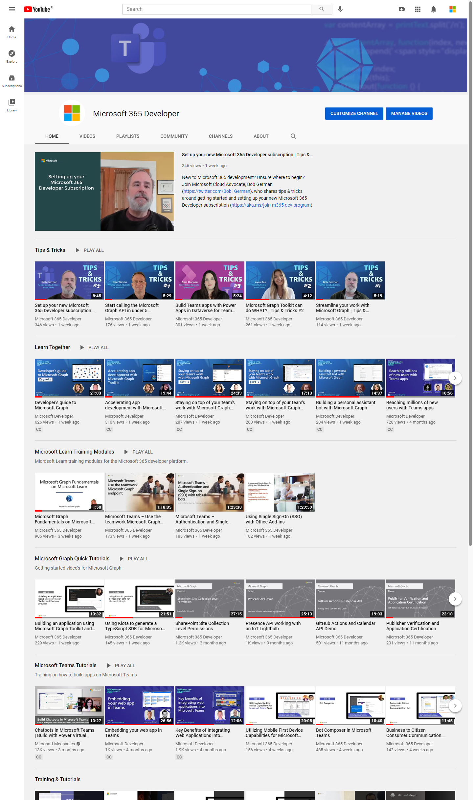
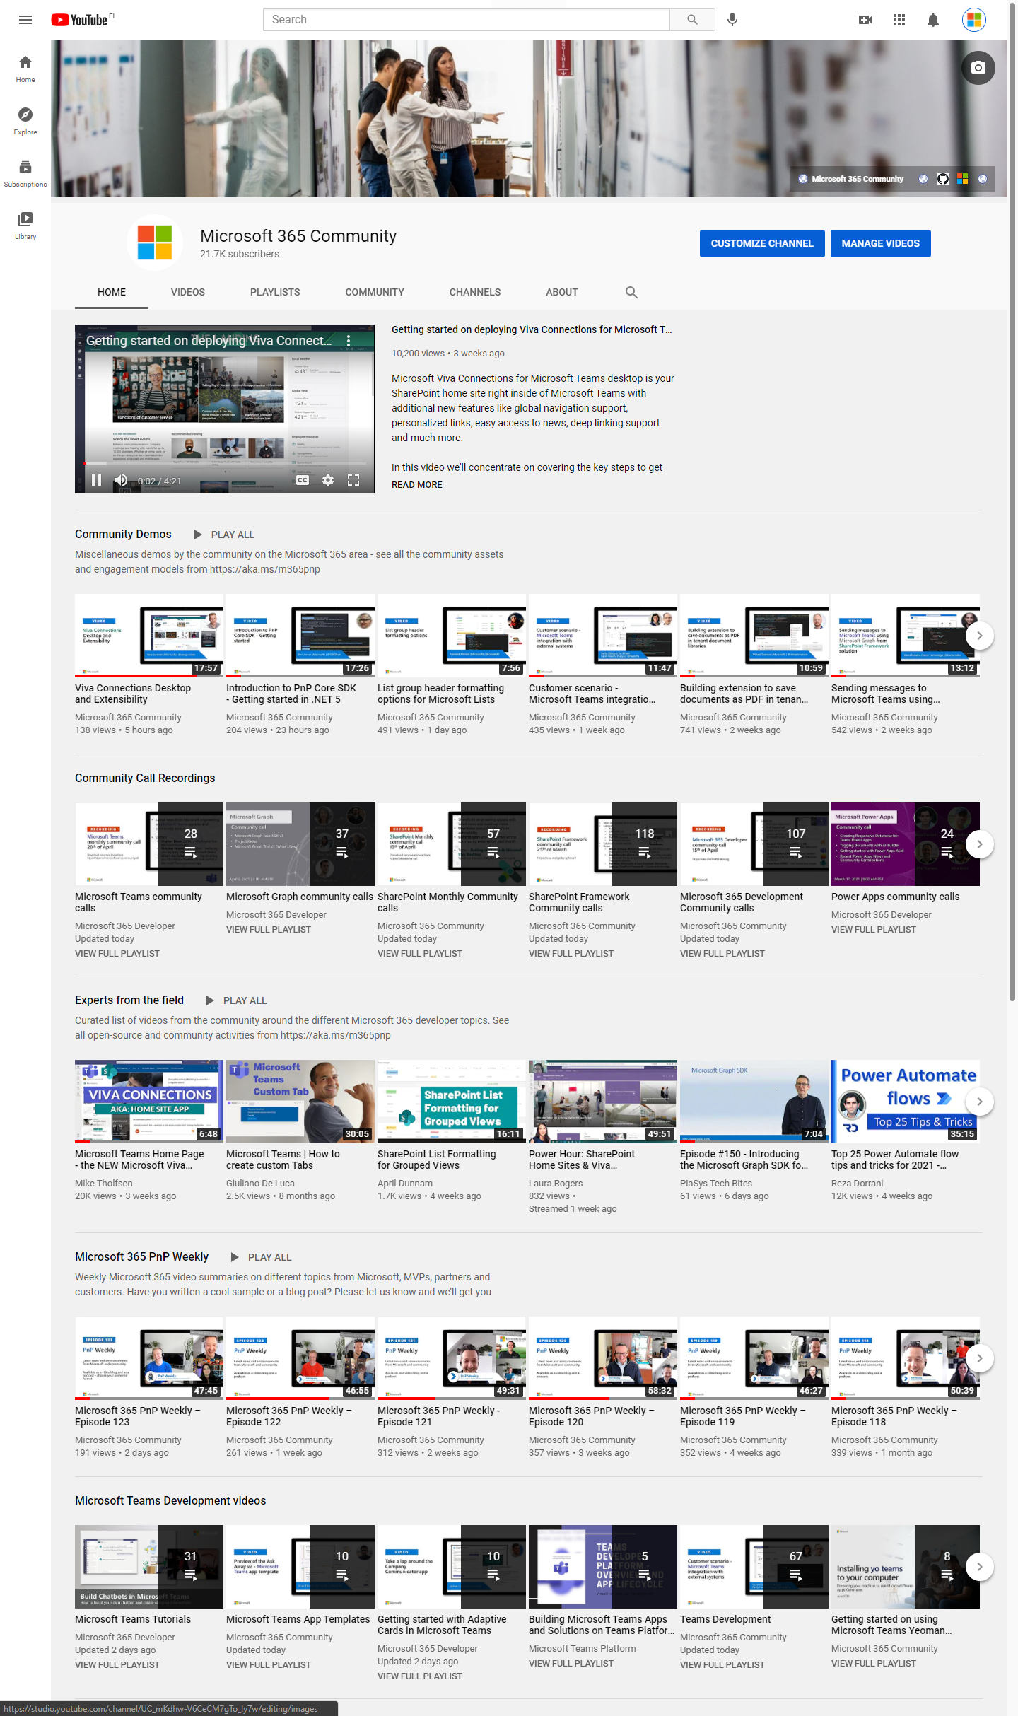
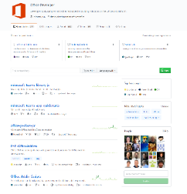
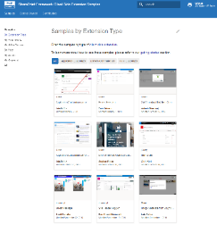
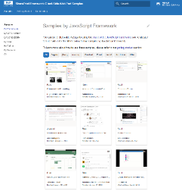
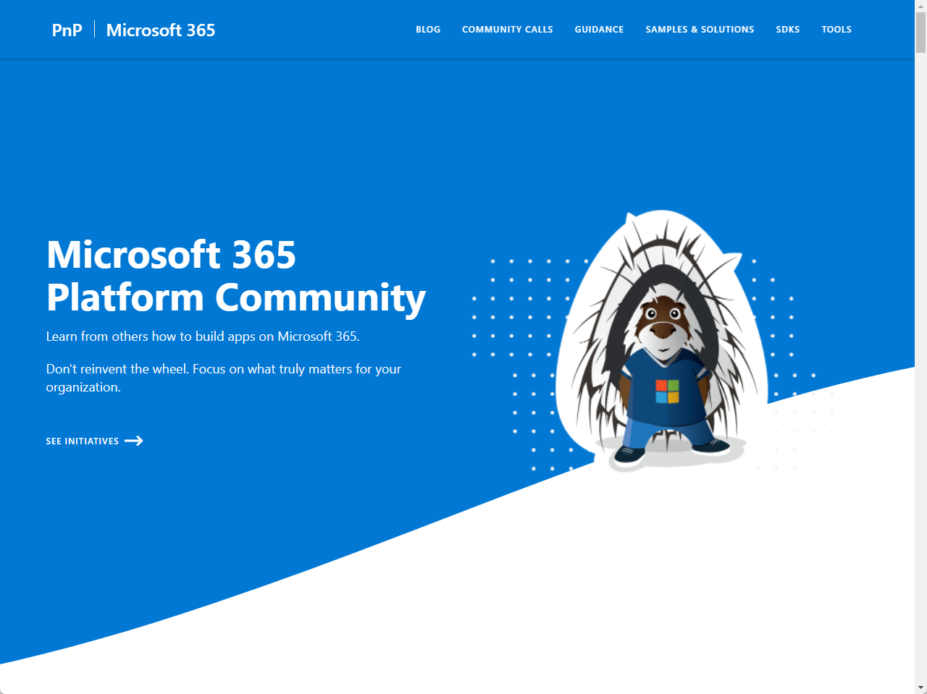
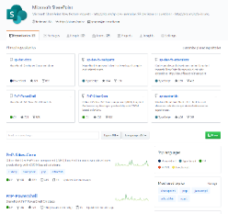
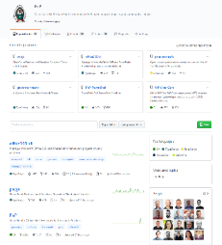
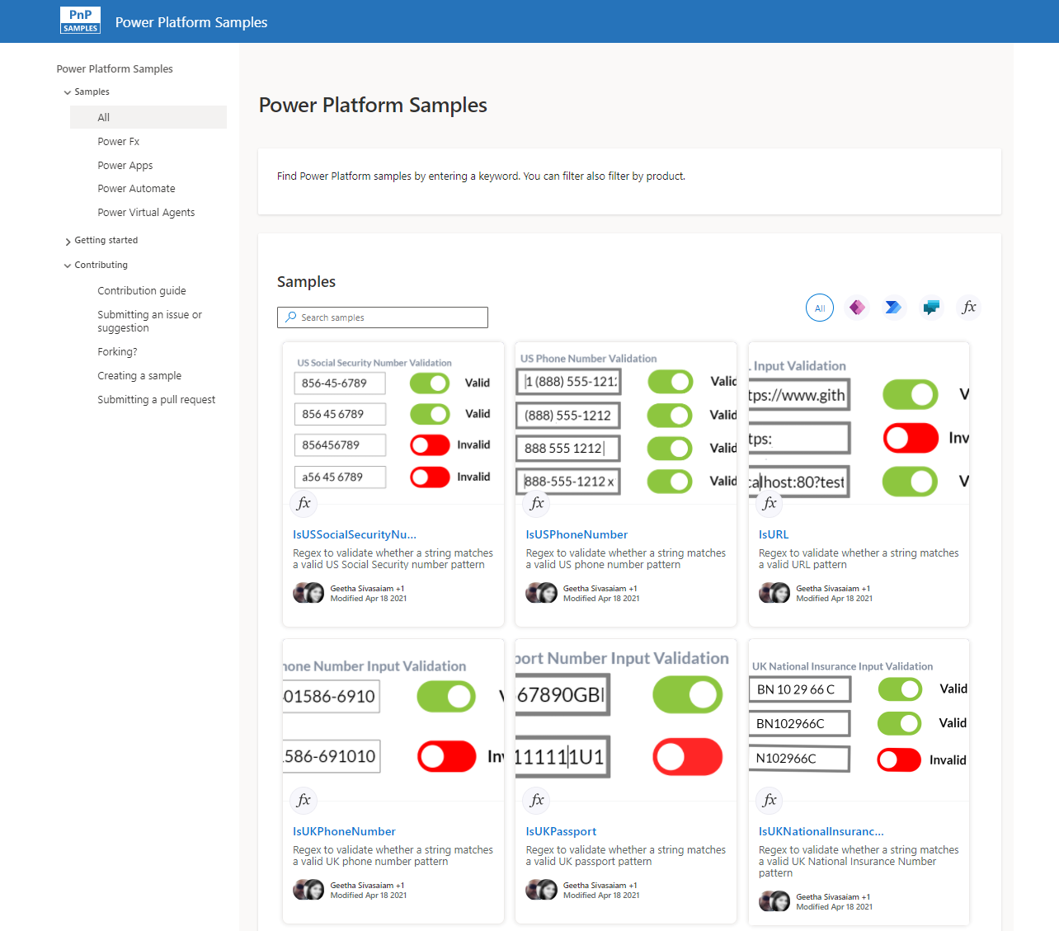
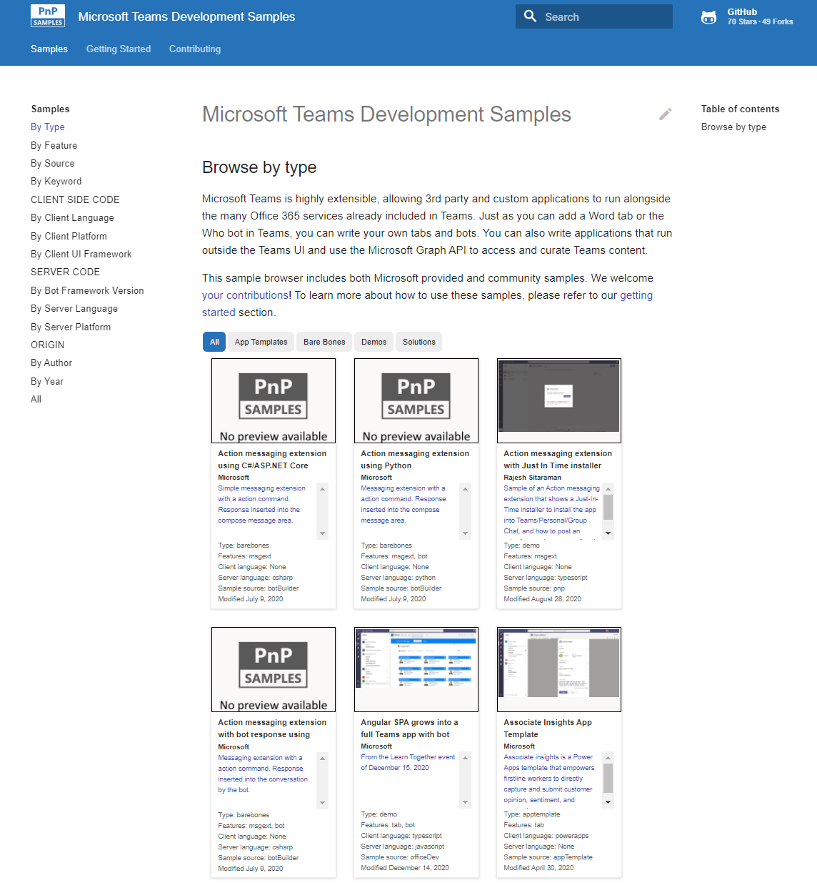
Microsoft 365 developer videos
Microsoft 365 community videos
Open-source
Sample galleries
Open-source initiatives and samples
aka.ms/m365devyoutube
aka.ms/m365/videos
github.com/pnp
github.com/officedev
github.com/sharepoint
github.com/microsoftgraph
aka.ms/m365/samples
aka.ms/teams-samples
aka.ms/spfx-webparts
aka.ms/powerplatform-samples
aka.ms/spfx-extensions
aka.ms/list-formatting
aka.ms/m365/community
@Microsoft365Dev | @m365pnp

Slide 4
Microsoft 365 developer community calls
Microsoft 365 platform (weekly) https://aka.ms/m365-dev-call
Adaptive Cards https://aka.ms/adaptivecardscommunitycall
Microsoft identity platform https://aka.ms/IDDevCommunityCalendar
Office Add-ins https://aka.ms/officeaddinscommunitycall
Power Platform https://aka.ms/PowerAppsMonthlyCall
Microsoft 365 and Power Platform community (bi-weekly) https://aka.ms/m365-dev-sig
Viva Connections & SharePoint Framework (bi-weekly) https://aka.ms/spfx-call
Download recurrent invites from
https://aka.ms/m365/calls
Notes:
m365-dev-sig

Slide 5

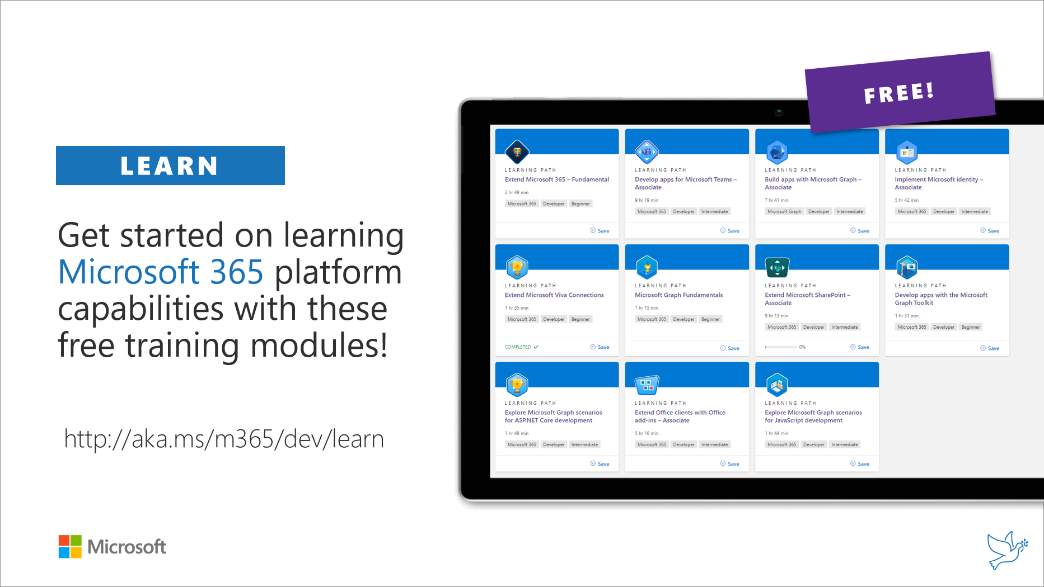
Getting started assets for Microsoft 365 dev
aka.ms/m365/devprogram
aka.ms/m365/dev/learn

Slide 6

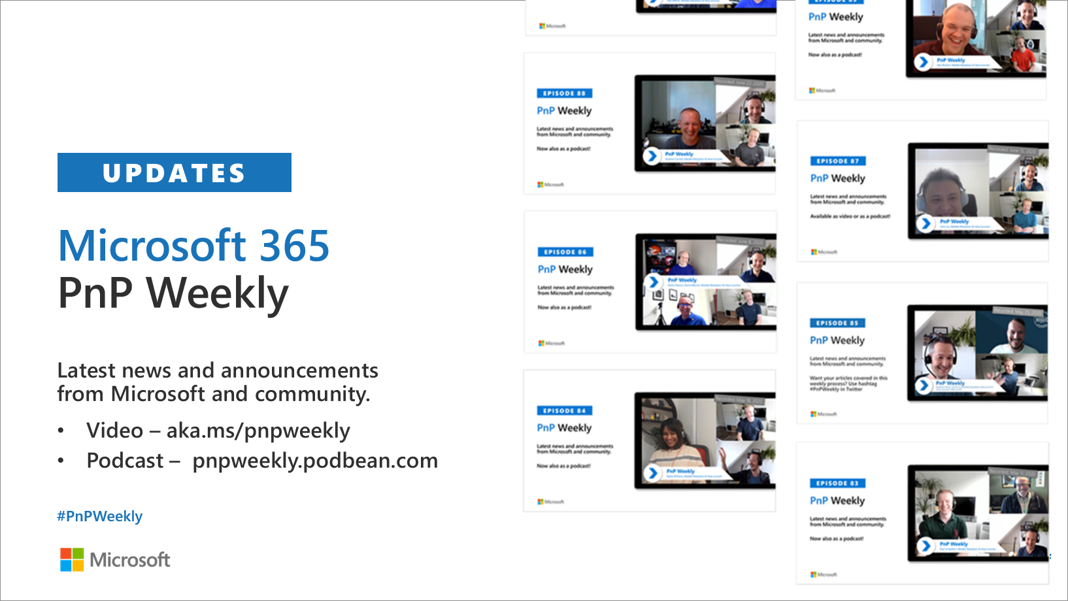
Microsoft 365 Developer podcasts
m365devpodcast.com
Video – aka.ms/pnpweekly
Podcast – pnpweekly.podbean.com

Slide 7

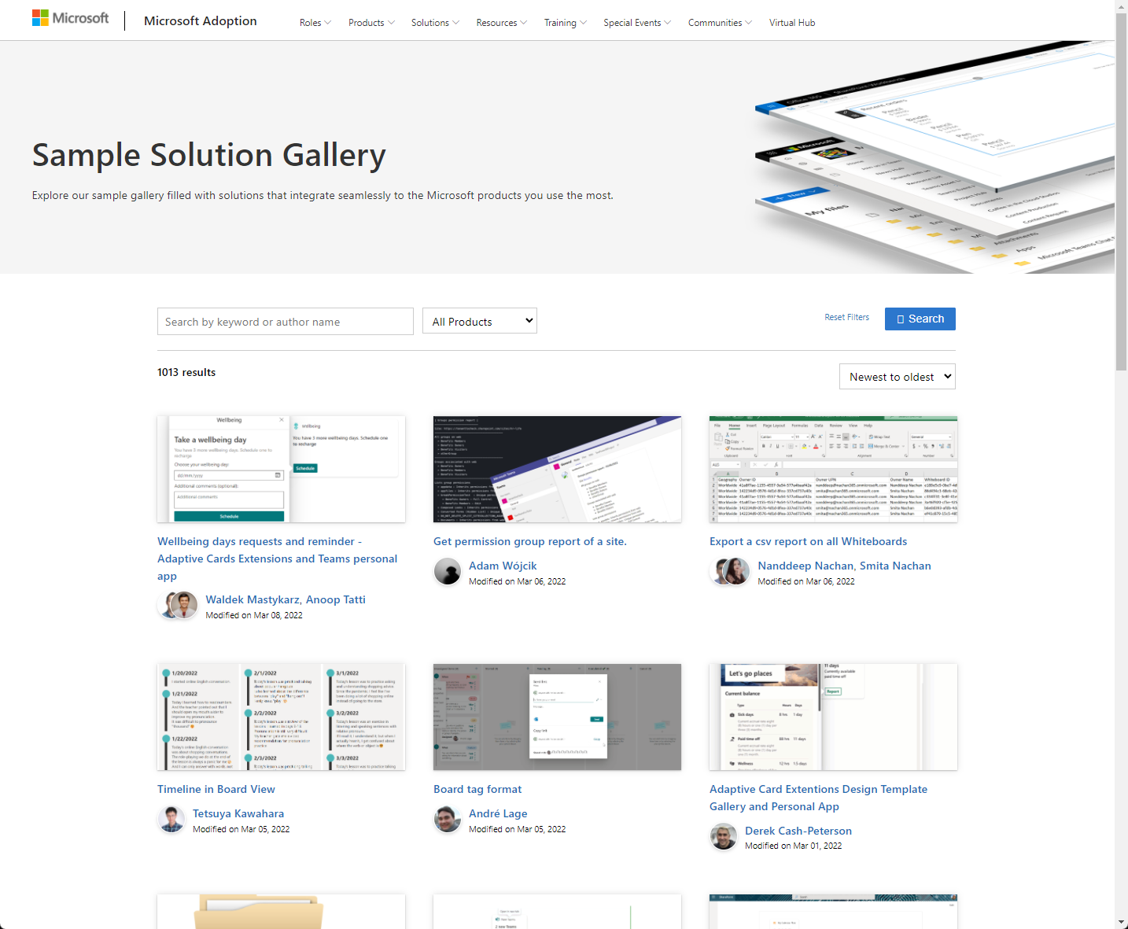
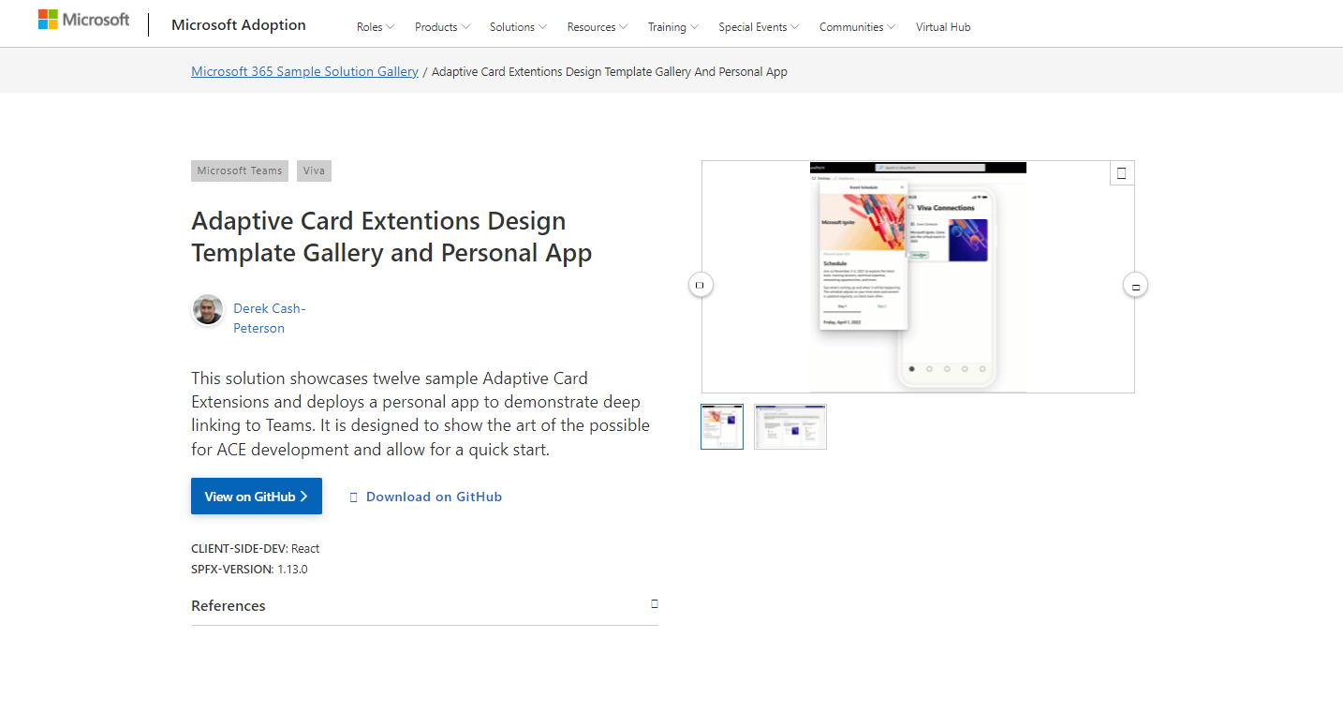
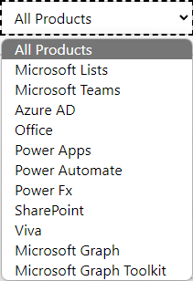

SAMPLES
New Microsoft 365 sample gallery with more than 500 samples from Microsoft and community
1100
aka.ms/m365/samples

Slide 8

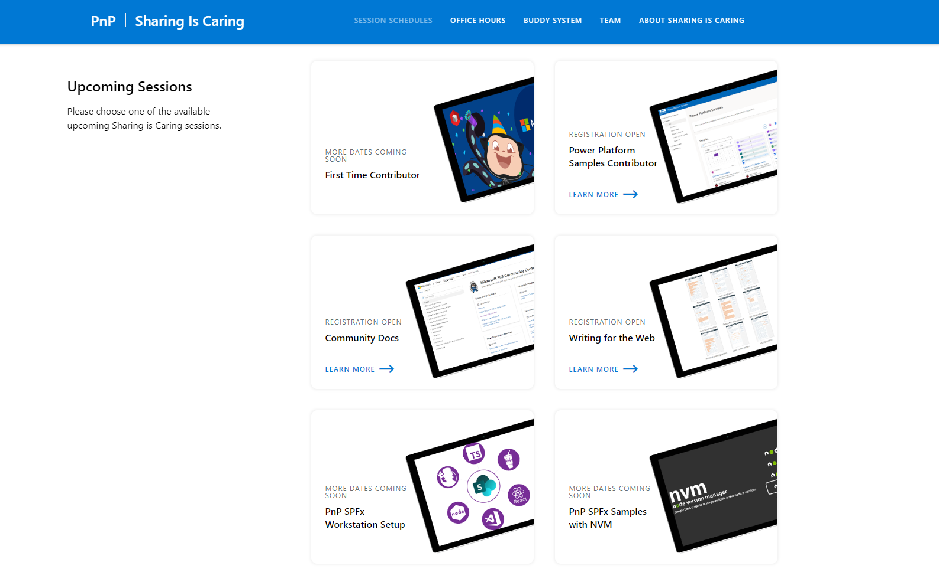
GUIDANCE
Learn how to get started in the open-source PnP community!
Upcoming Sessions:
General First Time Contributor
Power Platform Samples Contributor
Writing for the Web
SPFx Developer Workstation Setup
Using PnP SPFx samples w/ NVM
More than code with VS Code
First-time presenter
M365 Maturity Model Practitioners
Writing for the Web
Power Platform Samples Contributor
New Dates
Scheduling Soon!!
https://aka.ms/sharing-is-caring
Notes:
25 Total attendees, 16 attendees who attended both First-Time Contributors and Community Docs sessions.

Slide 9


ISV guidance on building solutions with monetization in Microsoft Teams
Async self-learning
https://aka.ms/app-camp
Online event on October 20th
https://aka.ms/TeamsAppCamp

Slide 10

EVENT
Registration now open:
https://ignite.microsoft.com

Slide 11

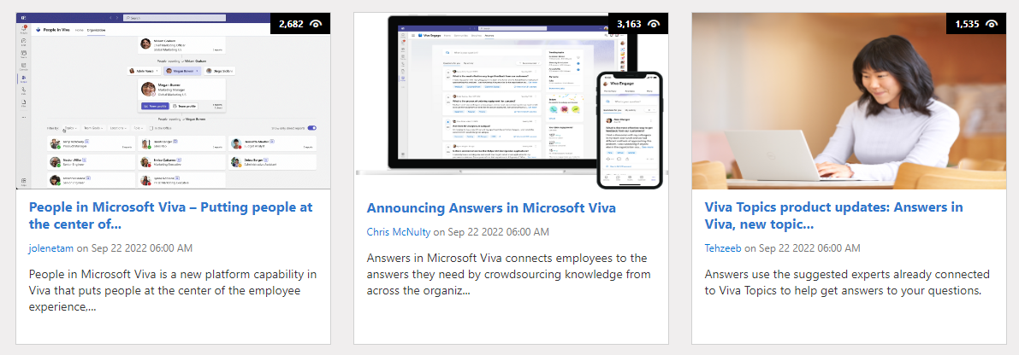
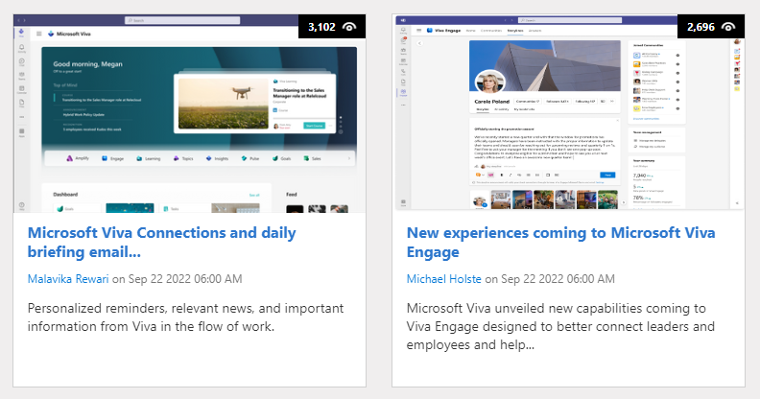
https://aka.ms/m365dev/blog
https://aka.ms/teams/blog
https://aka.ms/microsoftviva/blog
https://aka.ms/sp-blog
Notes:
Priority Matrix improves user activation by 20% -- https://devblogs.microsoft.com/microsoft365dev/priority-matrix-improves-user-activation-through-universal-actions-for-adaptive-cards/
Language Interpretation is now GA -- https://techcommunity.microsoft.com/t5/microsoft-teams-blog/language-interpretation-is-now-generally-available-ga-in/ba-p/3628382
Microsoft HRWeb Portal runs SP in MSFT -- https://techcommunity.microsoft.com/t5/microsoft-sharepoint-blog/microsoft-s-hrweb-portal-runs-on-sharepoint-in-microsoft-365/ba-p/3627806
Whats new and whats next for SP Server -- https://techcommunity.microsoft.com/t5/microsoft-sharepoint-blog/what-s-new-and-what-s-next-for-sharepoint-server/ba-p/3627729

Slide 12
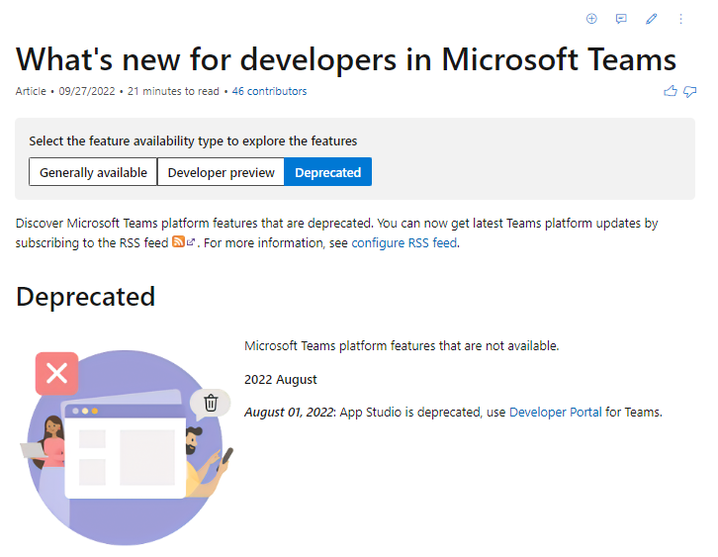
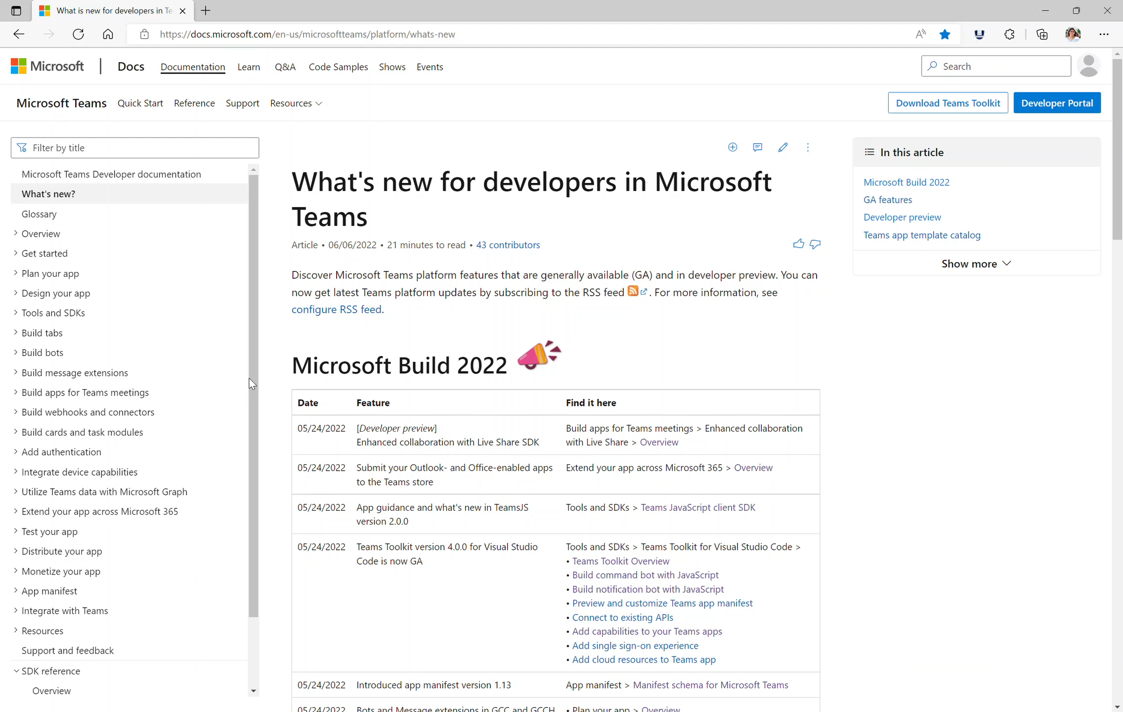






Teams Platform updates Documentation
Added section for Deprecated features
2
Enable SSO for tab apps – Share feedback
1
Docs: aka.ms/TeamsDevDocs > What's new > Deprecated
Docs: aka.ms/TeamsDevDocs >Add Authentication > Enable SSO for tab app
@Microsoft365Dev
aka.ms/TeamsPlatformUpdates
aka.ms/TeamsDevDocs
aka.ms/TeamsSamples
aka.ms/TeamsPlatformFeedback
Notes:
Wajeed covering 9/27/2022 Hello everyone. I’d walk you through the Teams platform updates. Today we have two updates to share on Teams platform documentation. Let’s start with the first one.
We have introduced zone pivots for What's new section which allows you to filter new features based on availability. You can now filter easily to check features which are GAed vs Developer preview. We also introduced Deprecated features section which will list Microsoft Teams platform features that are no longer supported/available. 2. Second update is on SSO for Tab apps – we have completed our revamp for Tab SSO documentation based on the feedback we received. This activity is being performed in phases. Phase one is completed with the SSO for tabs app section and we’d be working on Bots and ME next. In this update got: ​
- Clarity of steps and procedures for authentication ​
- Understanding of difference between SSO and non-SSO authentication methods ​
- Requirements and correct technical process for basic implementation of SSO authentication in a tab app​
- Improving discoverability of content by correcting ToC structure and page names.​
- The module must have sections such as Final output or behavior, help for the users to choose between options, and Troubleshooting guide​ ​
Please feel free to share your feedback. ​ So, these were the platform updates, if you have any feedback or suggestion, please post on aka.ms/TeamsPlatformFeedback- the link is available in the footer. You could also follow us on twitter and configure to the RSS feeds to get regular platform updates.

Slide 13

Optional picture time!
Video on and we’ll grab a Together Mode pic with those who are willing to do this.
We are together on this as a community!
Let’s all be like Seb
By enabling your camera for the picture, you grant us permission to share your picture in social media.

Slide 14

DEMO
Build a productivity dashboard by using Teams Toolkit for Visual Studio – Ayça Baş
SharePoint Framework – Latest status and the next investments areas
– Alex Terentiev
– Vesa Juvonen

Slide 15

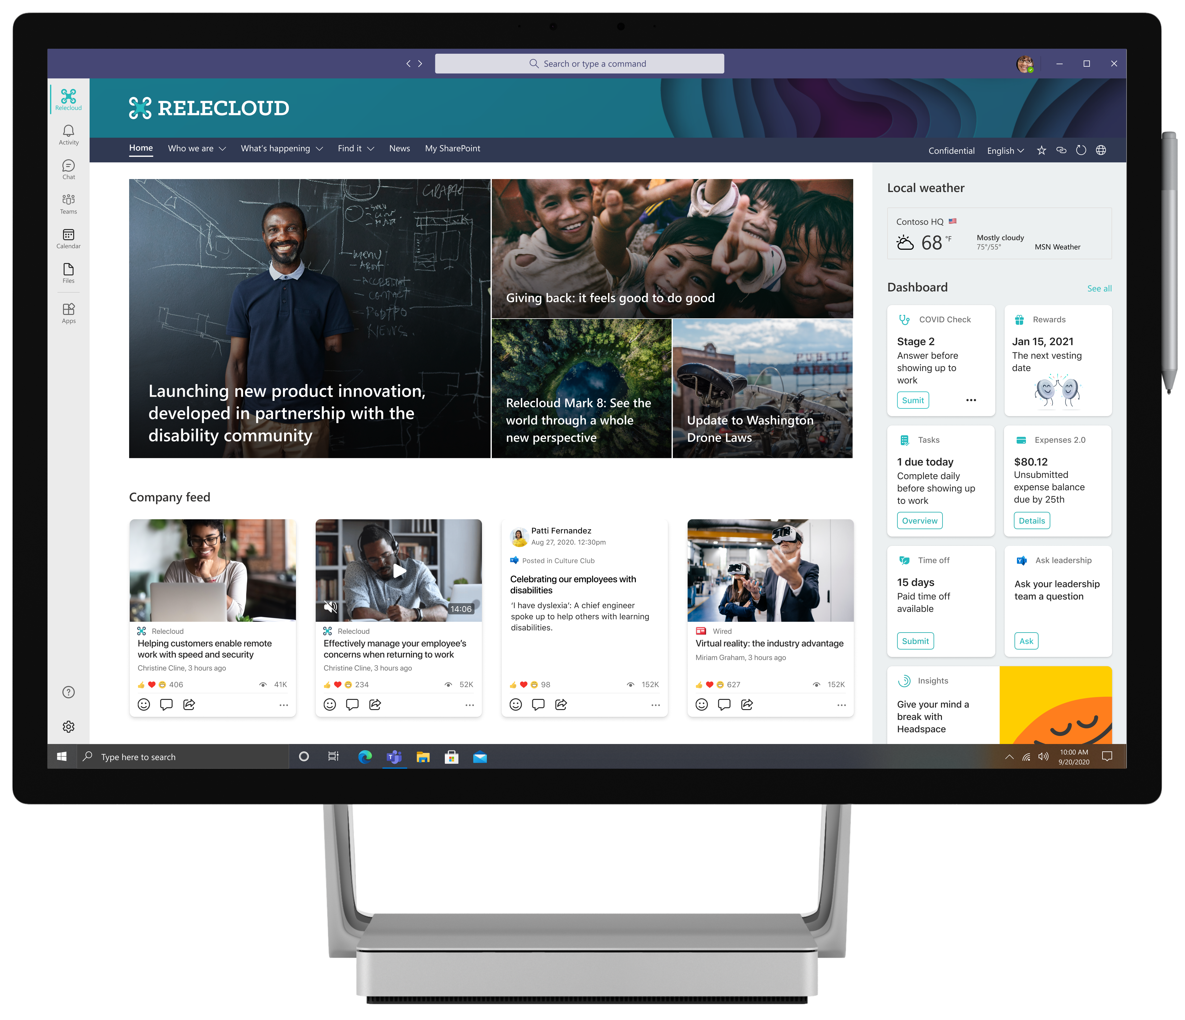
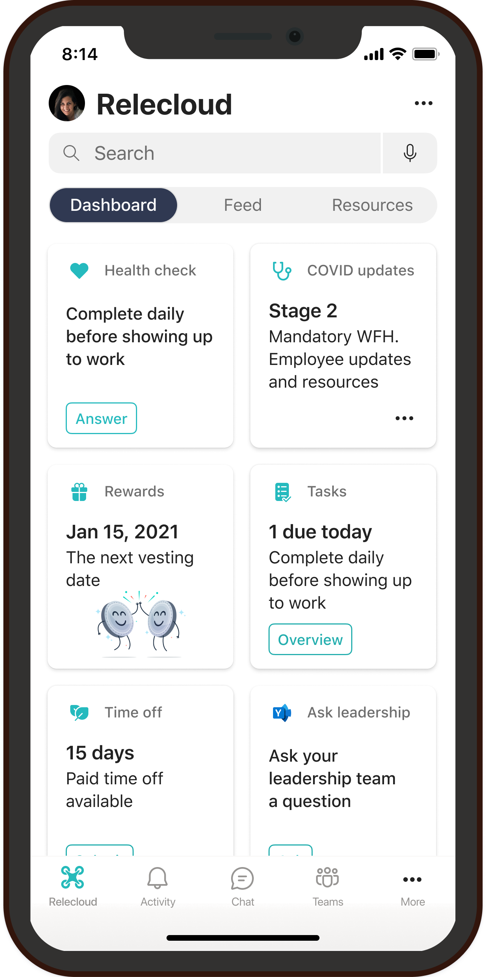
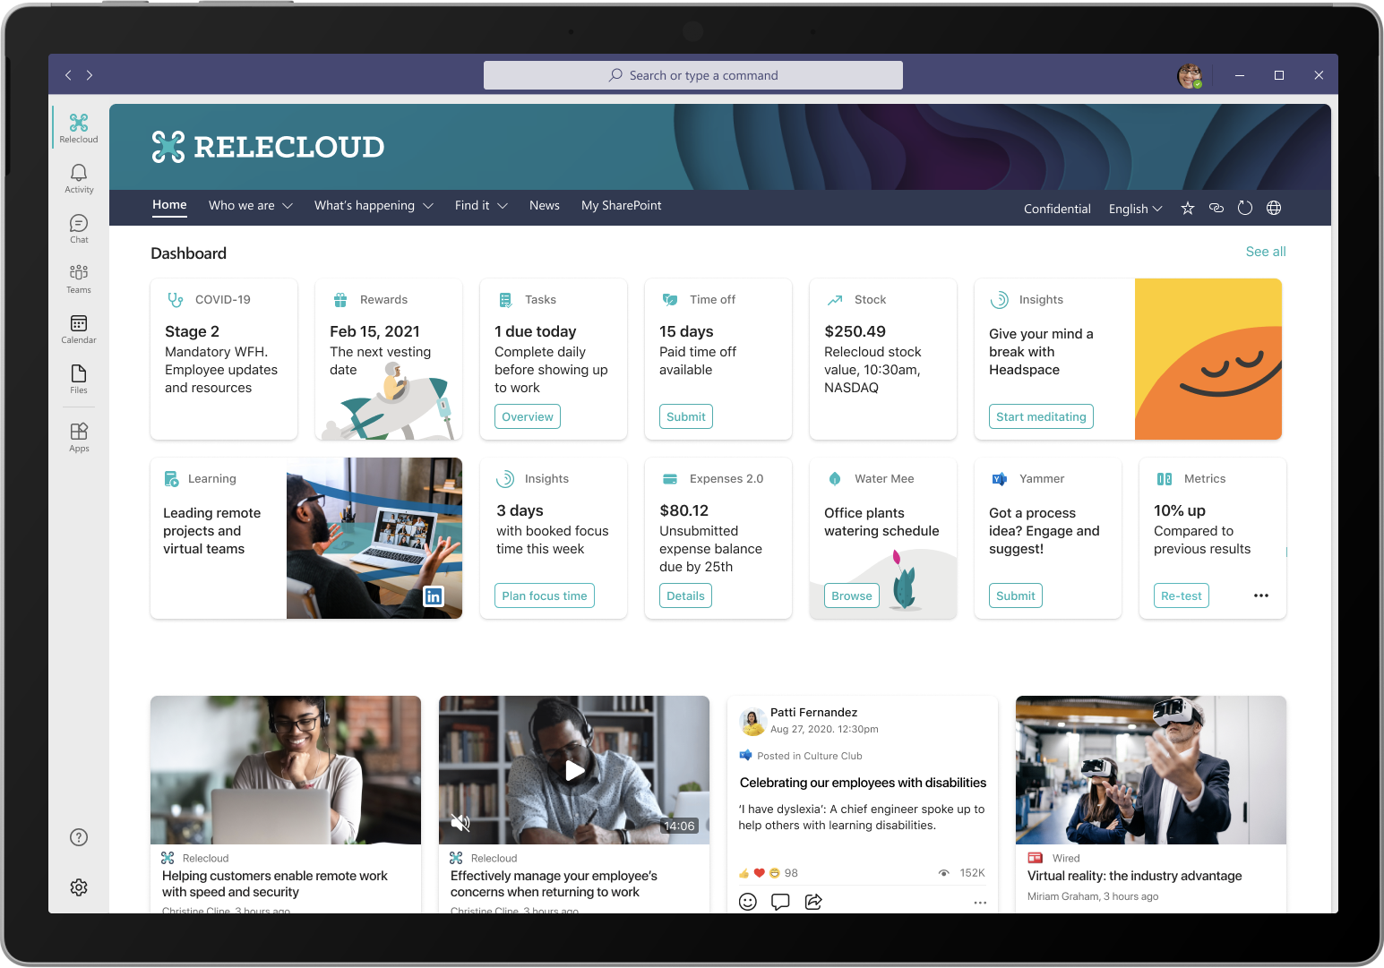
SharePoint Framework
The easiest way to build your enterprise solutions for Microsoft 365
Automatic Single Sign On
Automatic hosting
Consistent dev experience
Industry standard tooling

Slide 16
SharePoint Framework for Microsoft Teams, Microsoft Viva and SharePoint
and soon even more…
Microsoft Graph
Meeting apps
Web Parts
Custom tabs
Extensions
Task modules
Personal apps
Adaptive Card Extensions
Messaging extensions
Application pages

Slide 17
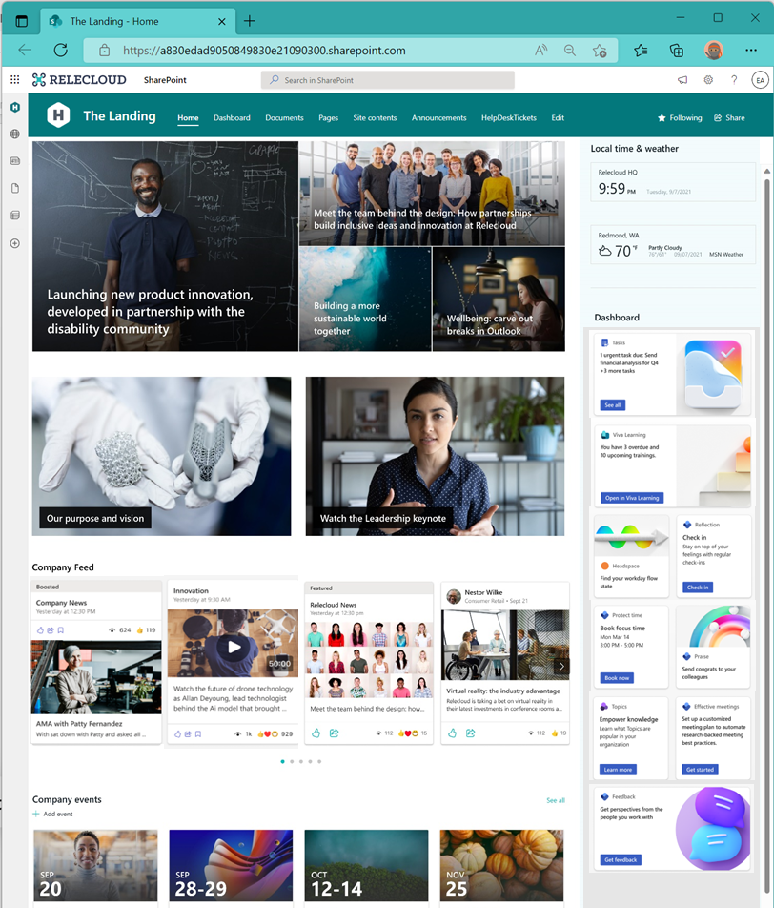
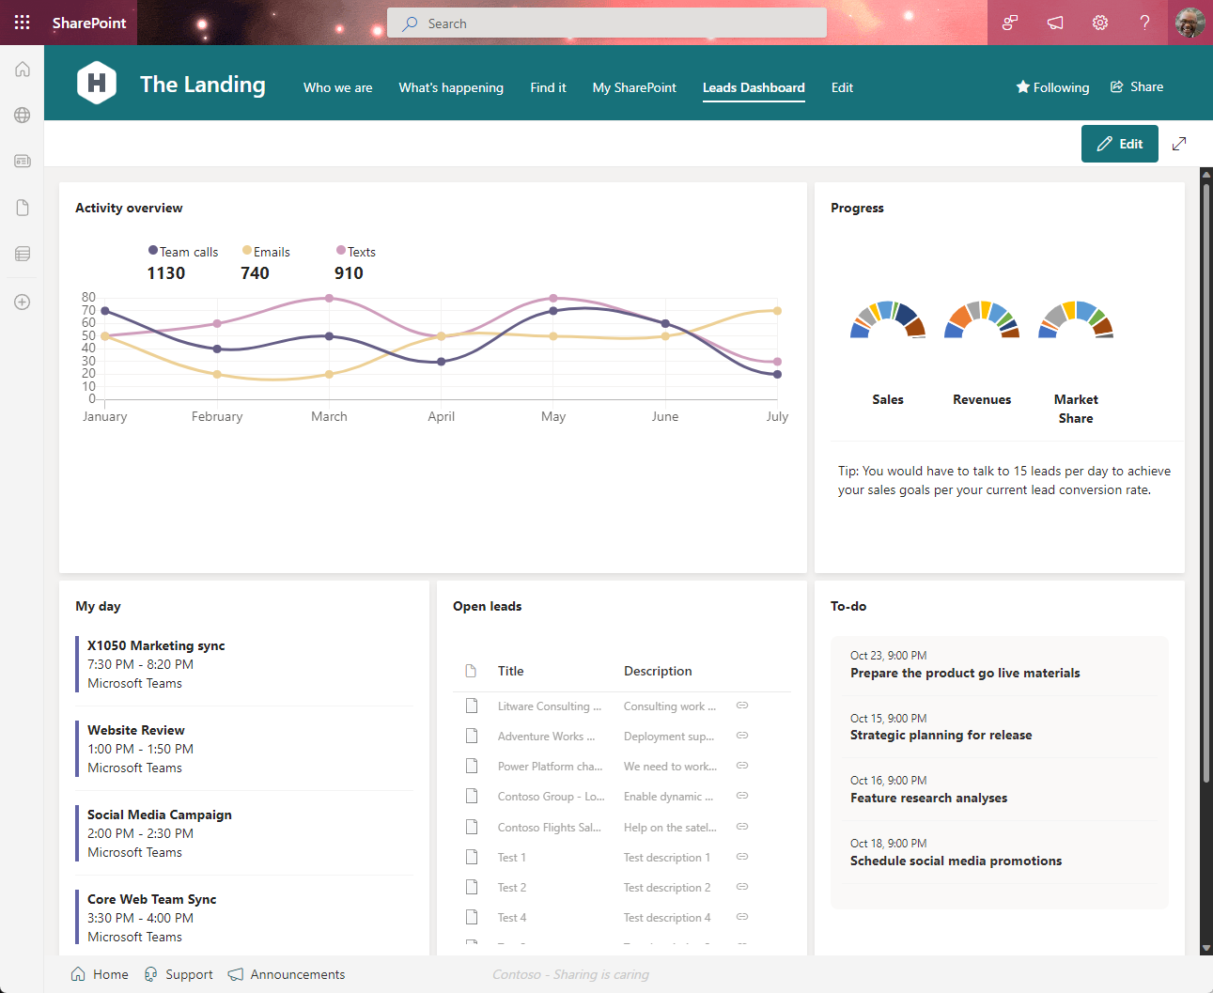
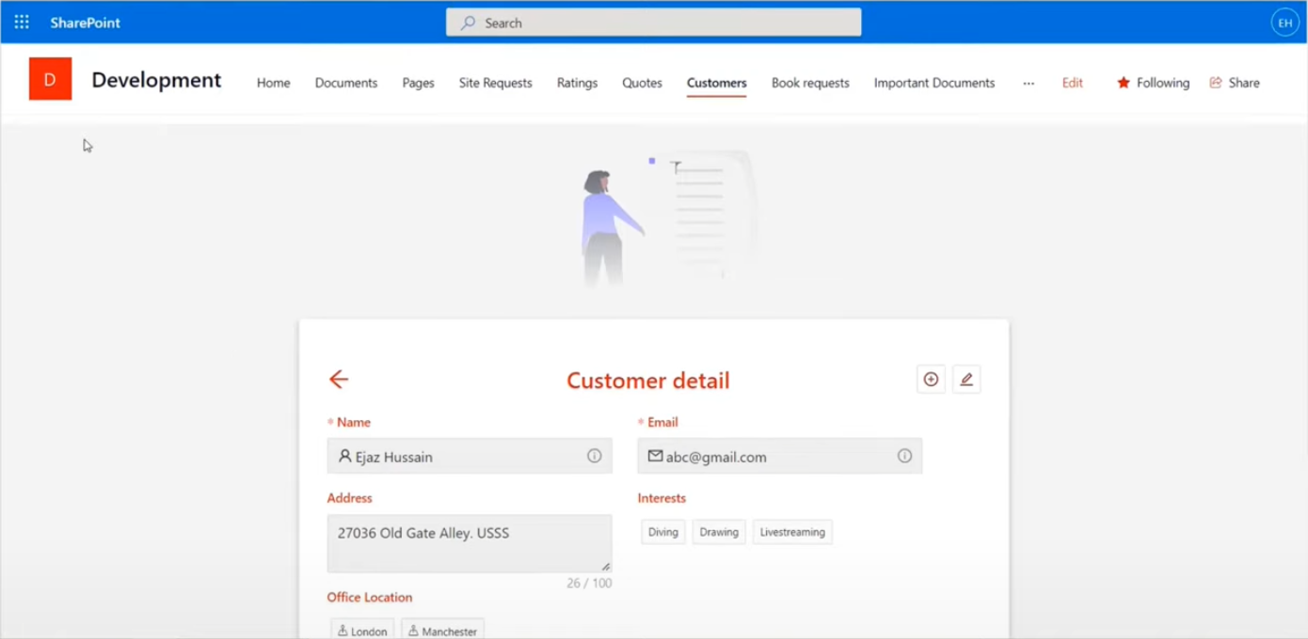
SharePoint Framework in SharePoint Online

Slide 18
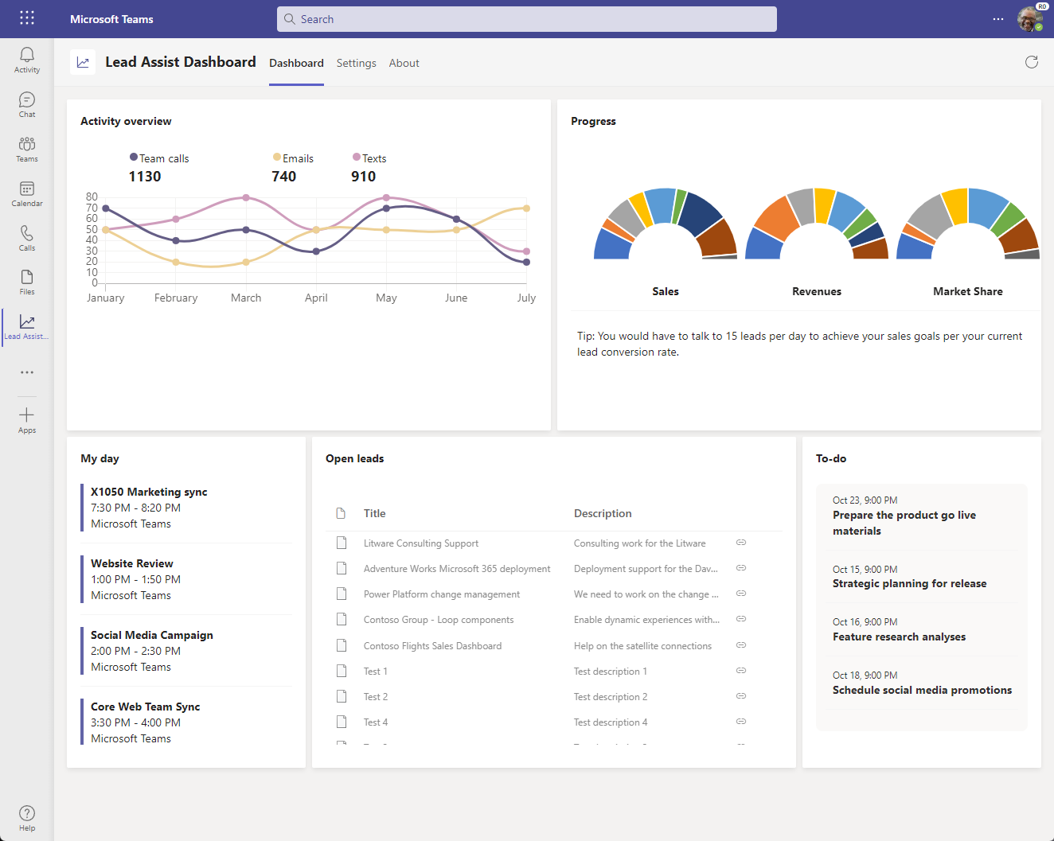
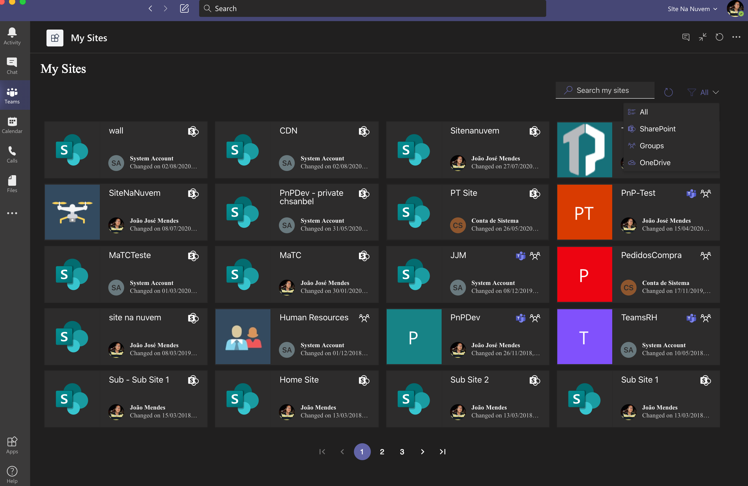
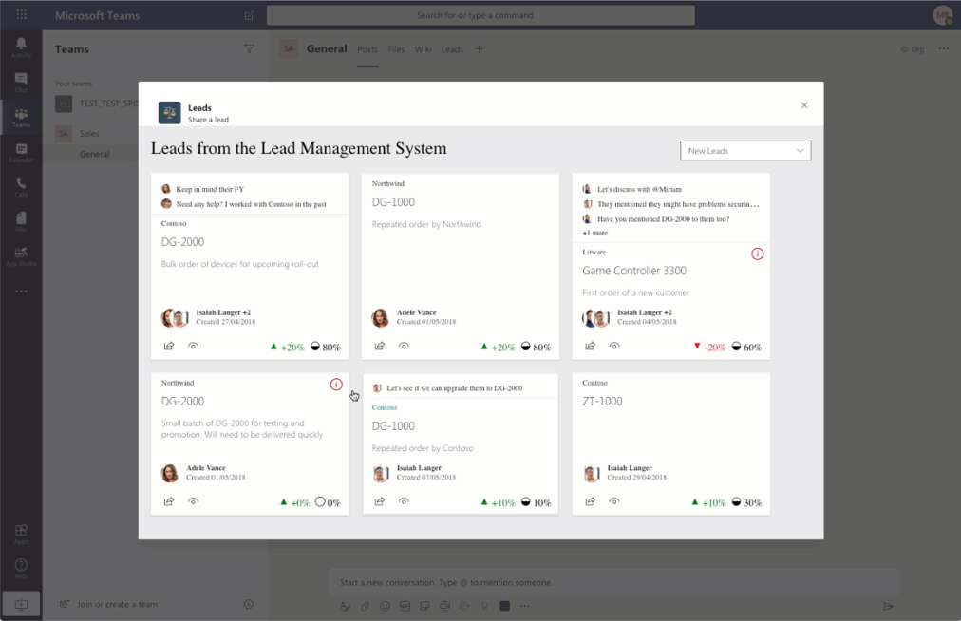
SharePoint Framework in Microsoft Teams

Slide 19
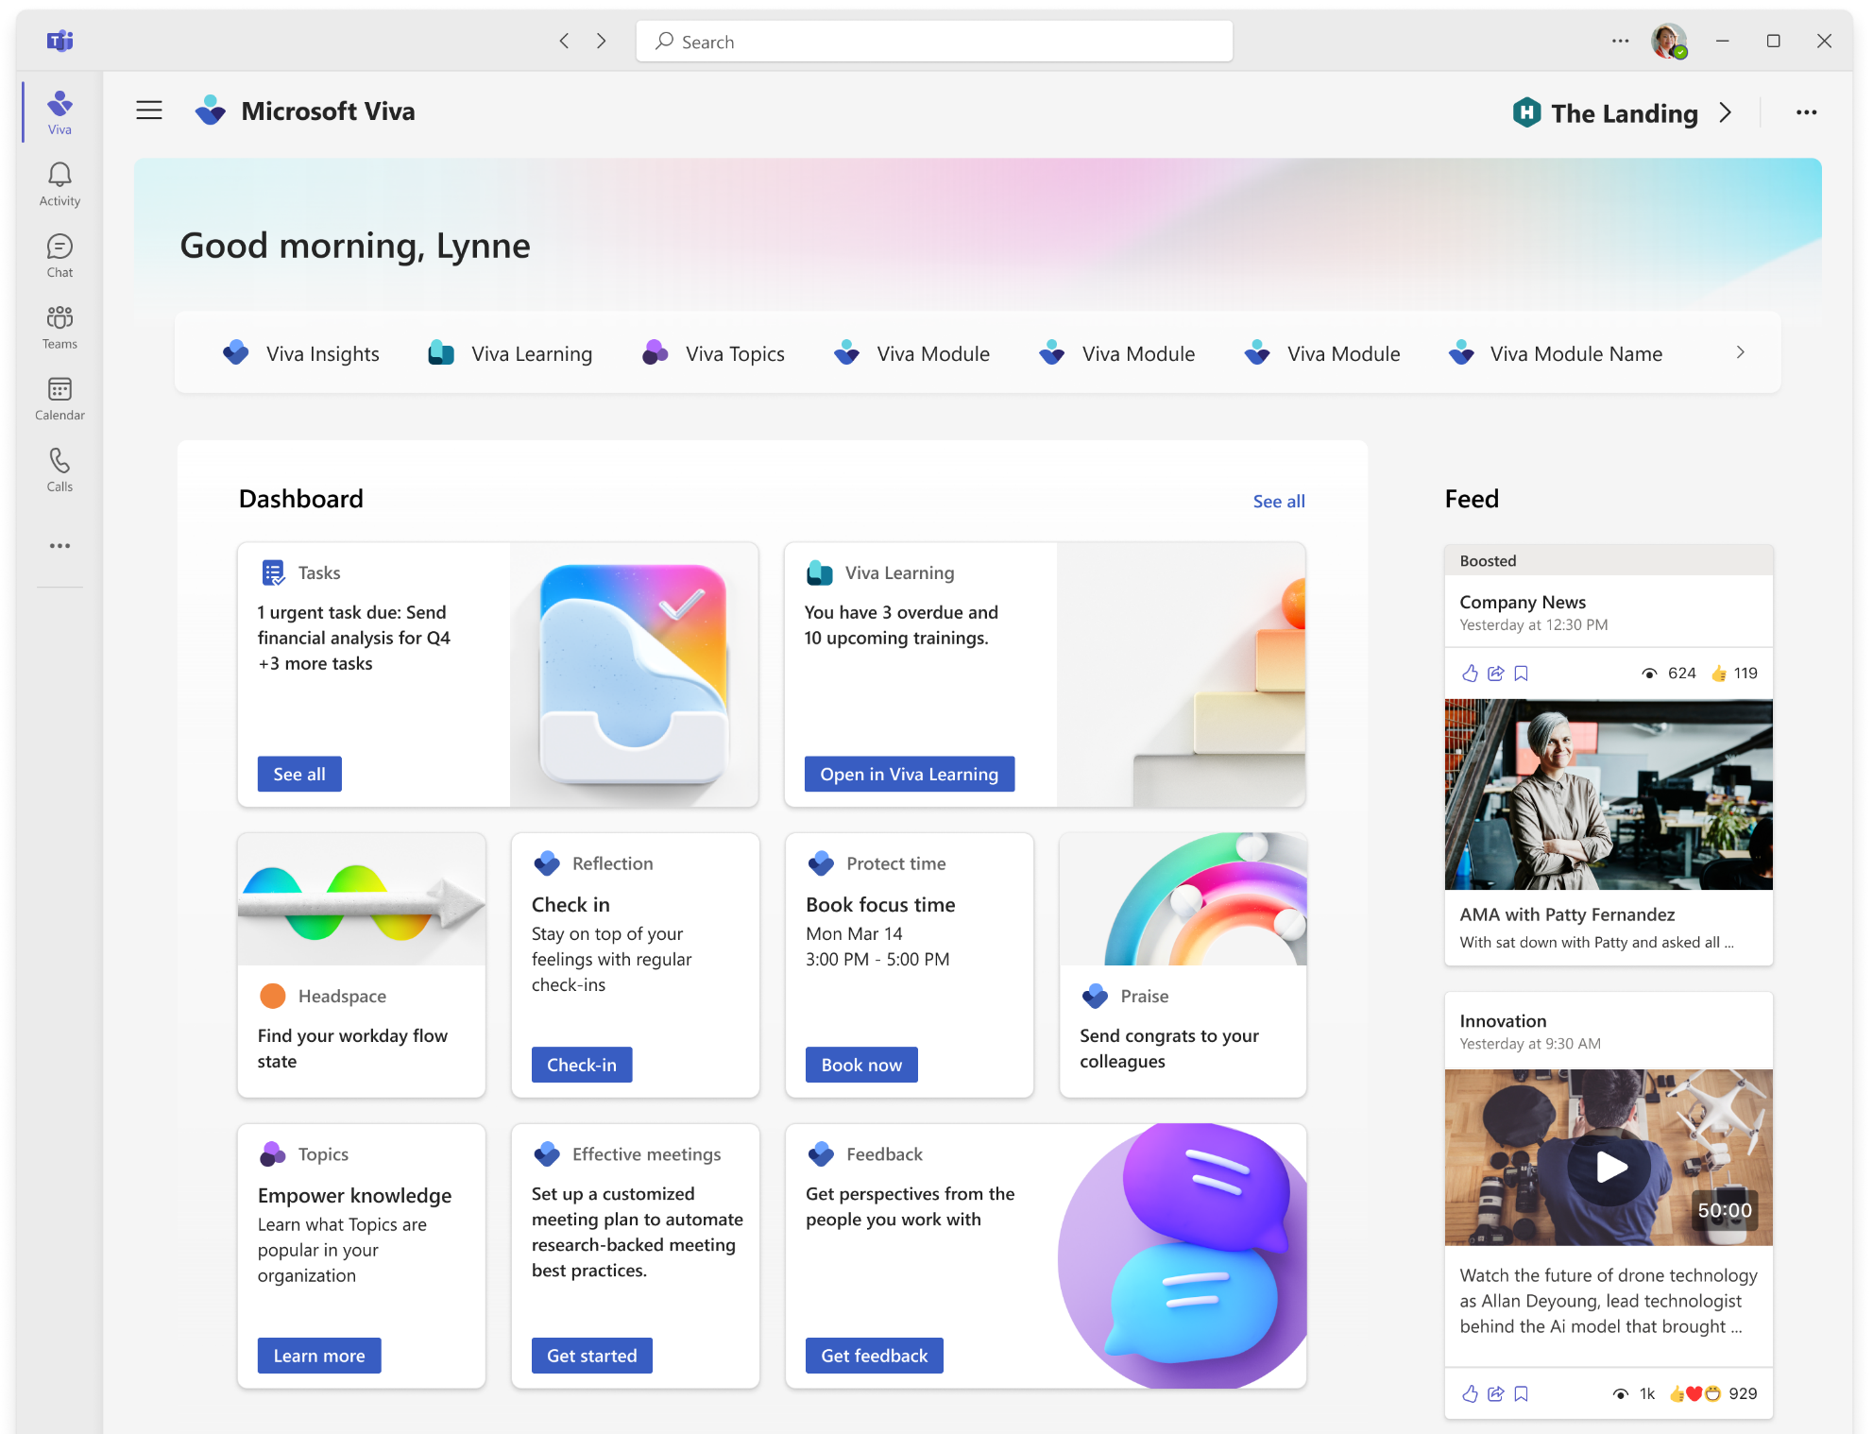
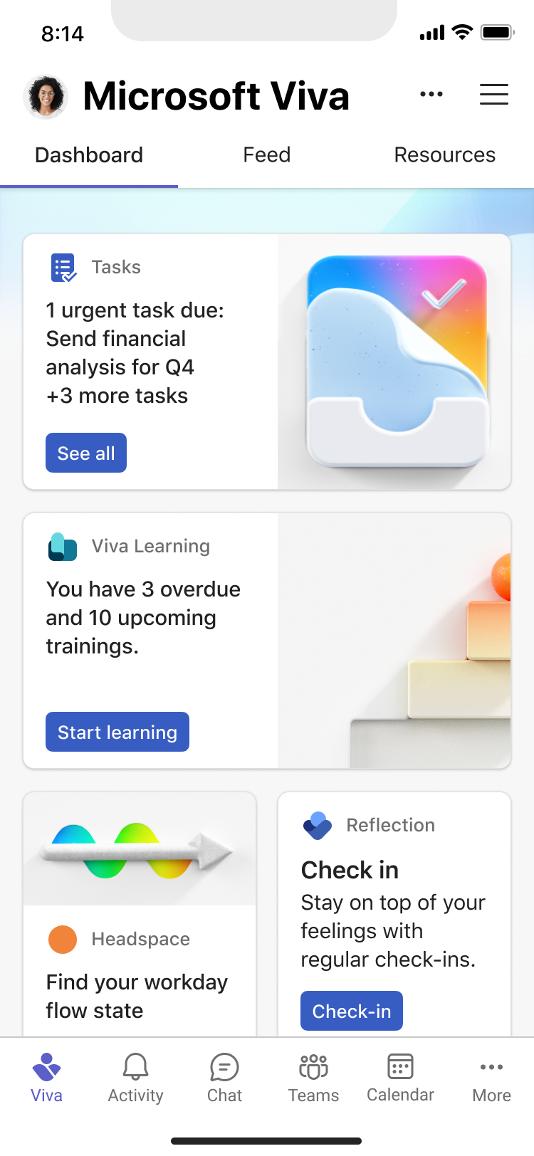

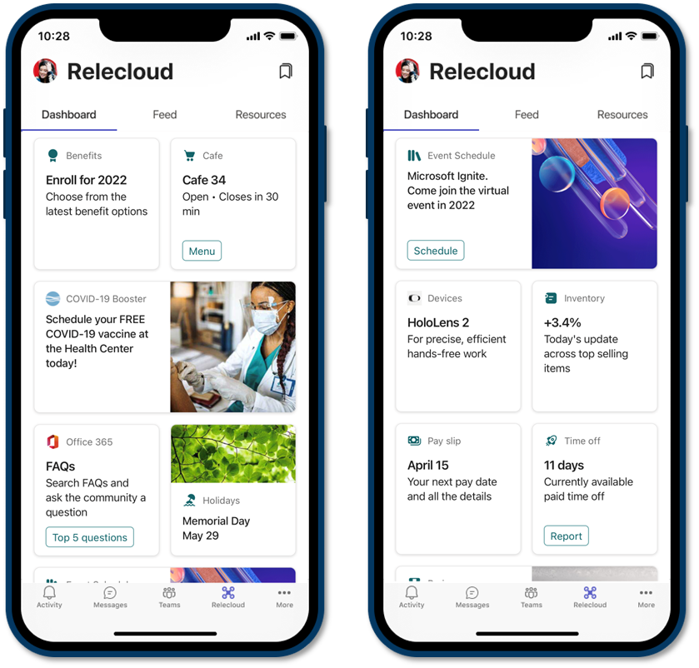
SharePoint Framework in Microsoft Viva

Slide 20







The Road Ahead – SPFx roadmap for Viva, Teams, SharePoint and more
1.15.2 – Released in August – latest in prod version
Enable Service Principal Registration in app acquisition flow
New media action type for Viva Connections
ESLint support update based on community feedback
Bug fixes and adjustments based on GitHub issues
1.16 preview released few weeks ago
Teams JavaScript SDK v2 native support in SPFx solutions – rolling out also to existing solution
Asynchronous support for Viva Connections ACEs rendering
New Top Actions support for web parts - Top Actions allow developers to add custom actions to web part's command bar. The feature is like property pane controls but based on cleaner UI approach.
… and more… 🚀
1.16 General Availability in by end of 2022
1.17 ETA in December/January
and more across Microsoft Viva, Microsoft Teams and SharePoint… and more.
*

Slide 21
DEMO
Getting started with the SharePoint Framework development for SharePoint, Teams and Viva

Slide 22
Thank you
Recording will be available in 24 hours on
Microsoft 365 Community (PnP) YouTube channel
https://aka.ms/m365/videos
(subscribe today)
Follow us on Twitter
@Microsoft365Dev | @M365PnP
Next Microsoft 365 Platform call: October 4th at 08:00 am PT
All available community calls from https://aka.ms/m365/calls

Slide 23



aka.ms/m365pnp

